Slide 1
Why We Must Ask Why of Machine Learning
interpretability and explainability of machine learning models and why that matters

Slide 2



Introduction
Stephen (Steve) Newman
Principal Software Engineer
Common Cloud Platform on AVEVA Connect
/newmancodes
/newmancodes
newman.digital

Slide 3
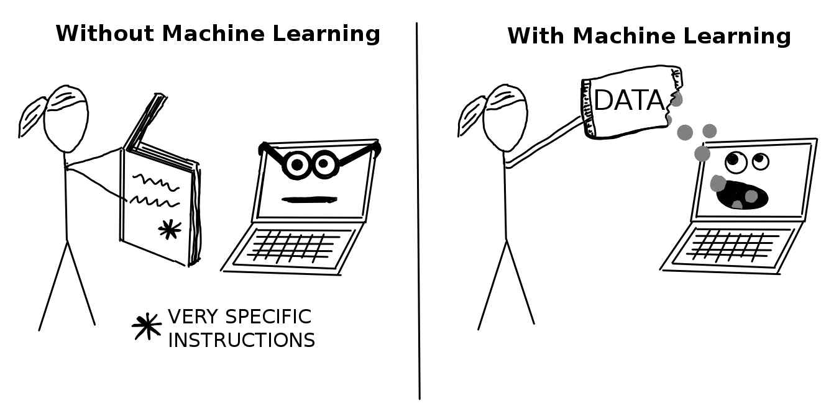
What is Machine Learning?
Sub-field of Artificial Intelligence (AI)
Supervised
Unsupervised
Semi-Supervised
christophm.github.io

Slide 4
Models Are Not Perfect
Predicting outputs from inputs

Slide 5
The Growth of Explainable AI

Slide 6
XAI Stakeholders
Developers
Users
Theorists
Ethicists

Slide 7
XAI Flavours
Interpretability
Explainability

Slide 8
Conclusion
Determine if an ML Model has XAI needs
Prefer Transparent over Opaque ML Models
Include Explainer Functions in MLOps pipeline

